Slide 1
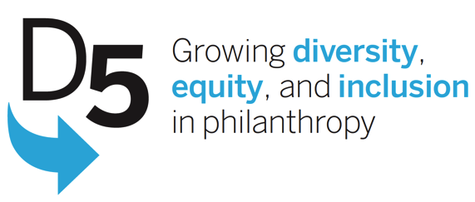

Philanthropic paths: An exploratory study of the career pathways of professionals of color in philanthropy
Presented by:
Arnold Chandler and Lisa Quay, Forward Change
Kelly Brown, D5
Hosted by: Maritza Guzmán, Public Interest Projects

Slide 2
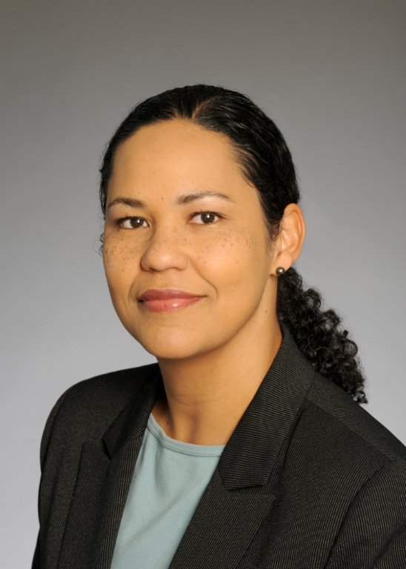
Welcome from Public Interest Projects
Maritza Guzmán
Program Director,
Public Interest Projects
Notes:
Kick off
Happy to be cosponsoring
Interest in webinar series
Stay tuned: coming attractions

Slide 3
Public Interest Projects helps donors develop innovative grantmaking strategies.
We create inspired spaces and opportunities for funders to maximize the impact of their grants, leverage their resources, and meet other like minded donors with the goal of thinking more creatively about the philanthropic sector’s role in advancing social change.
3

Slide 4
Before we begin…
Please mute your lines
Please use the chat box to ask questions
At the conclusion, please take the time to fill out the survey
We are recording this webinar to share online at www.publicinterestprojects.org and www.d5coalition.org
4

Slide 5
PIP – D5 Webinar Series
January 23: D5: Advancing Issues that are at the Core of All Communities and All Philanthropy
February 20: On-Ramps for Every Traveler: Enhancing Impact through Diversity, Equity, and Inclusion
March 27: Elusive Philanthropy Data: Opportunities and Barriers for Collecting Data to Tell Philanthropy’s Full Story
April 17: Commitment from the Top: The Role of Leadership in Advancing Diversity, Equity & Inclusion
May 22: Career Trajectories of People of Color in Philanthropy
Visit http://www.publicinterestprojects.org or www.D5Coalition.org for past presentations.
Notes:
February: D5 commissioned a landmark scan of programs, policies, and practices in philanthropy, identifying a wide range of resources to advance diversity, equity, and inclusion – how can we spread the word and build the will for action? Start with the “5 Ms” – Mobilizers, Missions, Money, Moments, and Movements.
March: Who works in philanthropy? Where do philanthropic dollars go? In our era of big data and in a field that recognizes the importance of data, why is the collection and sharing of demographic data so elusive? Join the discussion of lessons learned and ideas for moving forward.
April: Philanthropy Northwest shares what it has learned from CEOs and leaders in the field that are working to advance diversity, equity, and inclusion—and how those lessons can be applied in your organization.
May: In the first study of its kind, researchers interviewed people of color at a range of levels in philanthropy, including active practitioners and leaders and those that have left the field, to identify what got them in, kept them in, or influenced their decisions to leave philanthropy. Learn about the findings and the questions they raise for the field.

Slide 6
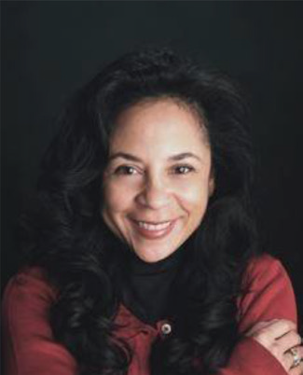
Kelly Brown
Director, D5 Coalition

Slide 7

Imagine philanthropy…
achieves lasting impact by drawing on the power of diverse staffs and boards
forges genuine partnerships with diverse communities
increases access to opportunities and resources
for all people.
the vision
Notes:
Kelly
- What D5 is/genesis

Slide 8




Four Big Goals
Recruit diverse leaders for foundations—including CEOs, staff, and trustees
Increase funding for diverse communities and ensure that foundations offer all constituencies equal opportunity to access the resources they need
Improve data collection and transparency so we can measure progress
Identify the best actions we can take in our organizations to advance diversity, equity, and inclusion
the priorities

Slide 9
Research Projects
WHAT WE DO
Commissioned three qualitative research projects in 2012
  Forward Change’s project
  Study of the role of leadership and dialogue in advancing DEI – April 2014 by Philanthropy Northwest: “Vision and Voice”
  Study of foundation and nonprofit interactions that advance DEI – June 2014

Slide 10

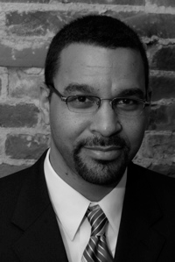
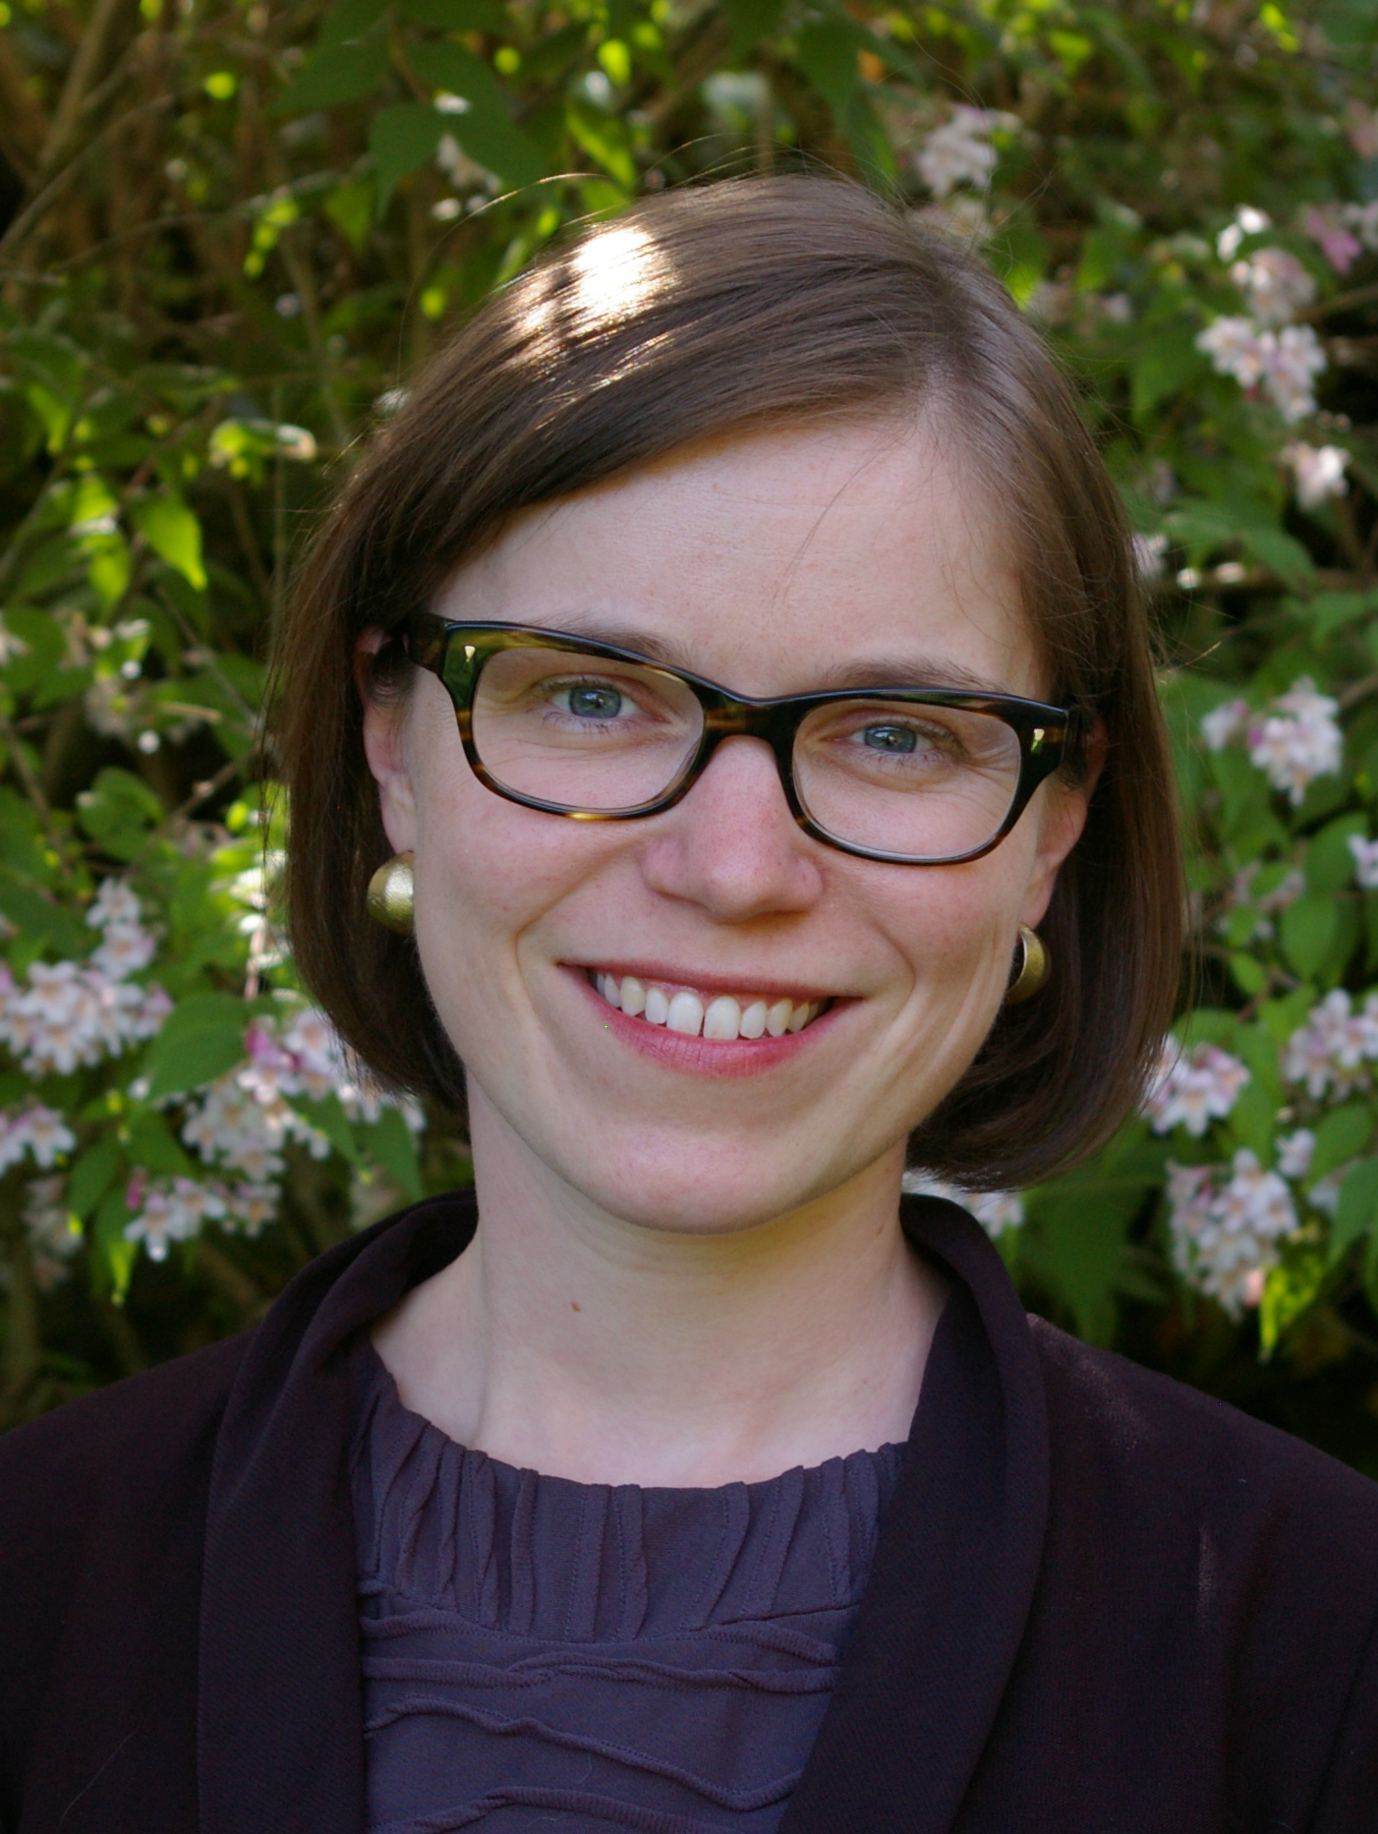
Today’s Conversation
WHAT WE DO
www.forwardchangeconsulting.com
Arnold Chandler
Lisa Quay
Notes:
Notes on voiceover:
Before jump into the report findings, want to give some context for this study:
While some progress has been made, people of color are still significantly under-represented in the senior leadership ranks in philanthropy.
When we looked at the research base on this issue, there really wasn’t much there; with the exception of some recent work by the Council on Foundations, much of the past research on this issue is either over a decade old or has a regional lens.
This research has been useful in elucidating trends and comparing professional experiences among racial and ethnic groups, but the field lacks an empirical understanding of how professionals of color have pierced the upper echelons of philanthropy—and the barriers and contributors to such paths. That was the genesis for this qualitative study.
Our goal was to provide the field with a richer exploration of how professionals of color enter foundations, how they advance across their careers, and what factors may impede or facilitate their advancement paths within the sector.
Today we’ll be highlighting some of the key findings from our report, which should be released by D5 in the next couple of weeks (?).
One thing to note is that there are some interesting overlaps between our findings about the barriers to advancement of professionals of color in philanthropy and those in a recently released report from ABFE exploring why black professionals are leaving philanthropy—so we recommended folks take a look at that report, as well
Last but not least, we want to thank the individuals who were so generous in sharing their experiences and insights with our research team and the broader field.
Also note that the quotes were taken from interviews conducted as part of the study.

Slide 11
Research questions
WHAT WE DO
What are the career pathways of professionals of color in terms of how they enter the sector and advance to higher levels of seniority?
What factors do they see as the greatest barriers and contributors to career advancement?
What do they see as the value of and challenges to diversifying foundation leadership?

Slide 12
Methodology
WHAT WE DO
Sample: 43 professionals of color with sector experience, selected non-randomly to achieve representation along several dimensions
Data collection: Semi-structured interviews examined the full span of philanthropic careers
Analysis: Interview transcripts were coded, categorized, and compared by 2 reviewers
CEO | Executive Team | Middle Manager | Program Officer
19 | 7 | 9 | 8
Notes:
Notes on voiceovers:
Sample
Selected interviewees from a list of over 600 professionals of color with sector experience
To capture the full breadth of experiences and perspectives, we intentionally selected a pool that provided representation on multiple dimensions (e.g., race/ethnicity, gender, geography, foundation type and asset size, how they obtained their current position)
Table shows that we oversampled senior leaders (CEOs, Presidents, Executive Directors, VPs and SVPs), but we also included a good number of folks at the middle management levels (AVPs, Directors, SPOs), and at the PO level
Data collection
Conducted 45-90 minute interviews with our case pool of 43 individuals
Interviewees were guaranteed anonymity, which is why we don’t report interviewees’ names or other personally identifiable information
Analysis
Interview transcripts coded, categorized, and compared by 2 reviewers to extract themes and data that could be summarized quantitatively
And the key implication of all this is that…
While this study sheds light on the type of patterns or themes that might be worthy of subsequent, more systematic study, our results are not generalizable beyond the 43 individuals we interviewed

Slide 13
Overview of key observations
WHAT WE DO
Career pathways of professionals of color
  Multiple distinct pathways to senior levels
  Paths from junior levels to senior ranks exist
Factors affecting advancement
  Barriers: Vacancies, networks, stereotypes and culture
  Contributors: Mentors, affinity groups, institutional commitment to diversity and inclusion
Value and challenges to diversifying leadership
  Diversity makes philanthropy more democratic and effective, but key challenges exist to greater diversity
Notes:
Notes on voiceovers:
Before we dive into our findings in detail, want to share a summary of the major highlights from the study:
Career pathways of professionals of color:
When we looked at the full span of our interviewees’ professional pathways into and within the sector, we see three primary, distinct pathways to senior levels of foundation leadership
While interviewees believed career pathways to senior ranks were limited and challenging, the experiences of many of our executive and CEO interviewees suggested such paths do exist to some extent within the sector
Factors affecting advancement
We asked interviewees what barriers they saw to their own advancement and the barriers they perceived to the advancement of professionals of color more generally in philanthropy…
We also asked them what factors contributed the most to their own personal professional advancement in philanthropy…
Value and challenges to diversifying leadership
When we asked interviewees what they saw as the primary value and challenges to diversifying foundation leadership, we heard that people believe diversity makes philanthropy more democratic and more effective in its mission, but that significant challenges exist impeding the diversification of the sector’s leadership

Slide 14
1. Career pathways: Means of entry
WHAT WE DO
Most entered philanthropy by applying to a job posting or direct recruitment by a foundation
  Only CEOs reported search firm outreach, and they were more likely to be approached once in the sector
Once in the sector, individuals seeking new positions increasingly relied on their network
  Majority still applied to job postings, but tapped connections to provide a subsequent endorsement
Notes:
Notes on voiceovers:
We asked interviewees to tell us how they entered the sector initially, and how they obtained subsequent positions and jobs at new foundations after this initial entry.
First finding re: initial entry:
Applying to a job posting that they found or that was shared with them by a colleague, mentor, or friend was particularly common among POs and Middle Managers
Direct recruitment by a foundation was relatively consistent across seniority levels
The fact that CEOs were more likely to be approached once in the sector suggests that search firms may be more likely to identify and recruit individuals who are already in philanthropy
Second finding re: subsequent moves to new foundations:
Twice as many subsequently had someone connected to the hiring foundation support their candidacy with a personal endorsement once they had applied (vs. those who did this for their first job)
Network became more and more crucial as people moved across multiple foundations

Slide 15
1. Career pathways: Motivation
WHAT WE DO
Interviewees had 2 common motivations for entry:
  More systemic role in advancing social change
  Advancing a certain issue
But others simply “fell” into the sector
  Sizable number weren’t seeking a job in the sector
  Several were previously unaware of philanthropy
“What ultimately led me to philanthropy [was] the ability to think about issues at the root-cause level and with a transformational, justice orientation, rather than just a service-oriented, transactional framework.”
Notes:
Notes on voiceovers:
Among those who shared a reason why they entered, the overwhelming majority cited one of two reasons…
Interestingly, though, others simply seemed to “fall” into the sector:
A sizable number weren’t seeking a job in the sector—often looking in the non-profit sector more generally
Several were previously unaware of philanthropy until they were approached by a foundation or someone shared a posting for a foundation job with them

Slide 16
1. Career pathways: Advancement
WHAT WE DO
We saw 3 primary advancement patterns in the pool:
Rising within 1 foundation
Rising predominantly within 1 foundation
Moving up across multiple foundations
Foundation #1
Foundation #1
#2
Foundation #1
#2
#3
CEO
CEO
CEO
CEO
CEO
CEO
Exec Team
Exec. Team
ET
ET
ET
Exec. team
Middle Manager
Middle Manager
MM
MM
Middle Manager
MM
Program Officer
PO
Program Officer
Report Findings
Program Officer
PO
PO
Program Support
Program Support
PS
PS
PS
PS
Note: Diagrams are illustrative.
Notes:
Notes on voiceovers:
The majority of our interviewees experienced advancement within the sector; among these individuals, all but one followed these three distinct patterns, which all showed up with notable frequency in the pool:
In the 1st pathway depicted here, an individual enters the sector via a certain foundation and they have risen up the ranks since then through a series of internal promotions within that single organization. For some interviewees, this meant going from Prog. Asst. to Prog. Assoc. to PO. For others, this meant going from SPO to Director to VP to SVP to President and CEO
In the 2nd pathway, most of their upward movement occurred in the context of a single foundation, although they left that foundation for a new, more senior role in another foundation. As one example, they make it all the way from PO to the #2 job and see no prospects for a jump to the top job and either seek out or are recruited for an ED or CEO role at another foundation
The 3rd pathway represents another very distinctive pattern we observed: people would move up the ranks by jumping up across foundations. Each time they left for a new foundation, it typically was for a bump in seniority. Sometimes, they stayed in a certain position for a while but others moved relatively quickly through several foundations this way. For some, this seemed to be an intentional approach while others followed opportunities as they were presented (or were forced upon them due to personal circumstances)
Only two people ended up moving up through a pretty balanced mix of internal and external promotions; all of the rest clearly fit into these three categories
Most interviewees did not actively plan to rise to the senior-most positions; rather, a desire for professional growth or greater impact were key motivators for pursuing advancement opportunities.

Slide 17
1. Career pathways: Sector mobility
WHAT WE DO
Interviewees see few chances to rise to leadership
  Advancement to senior ranks seen as difficult, unlikely
  Most junior and mid-level staff saw no further room for advancement internally, even if promoted previously
“No one leaves. [And] for people who come in as junior professionals, even if your skills develop, folks have frozen in their minds how you came into the organization, not who you’ve become.”
But leaders’ experiences suggest such paths exist
  Vast majority of CEOs and Executives interviewed entered sector as junior staff
Notes:
Notes on voiceovers:
Past research has suggested that foundations do a lot of hiring outside their organizations for senior positions (either within the sector or in a different sector altogether)—and that there aren’t really “typical” or traditional, well-hewn paths from junior to more senior roles
Thus, there is concern that despite increased penetration of people of color in the lower and middle ranks, the field will continue to struggle with a lack of diversity at the top
These findings appear to represent somewhat of a contrast to other sectors (e.g., for profit) and professions (e.g., doctors, lawyers, educational administrators):
In philanthropy: >3/4 of CEOs were hired from outside the hiring foundations, and 2/3 were hired from outside philanthropy
In the for profit sector: roughly ¼ CEOs are hired externally
This perception was definitely present among our interviewees…
However, the actual experiences of the CEOs and Executives we interviewed suggested this may not be as true in reality as it is perceived (although both findings are notable)…
Potential disconnect between perceived opportunities and reality with regard to upward mobility in the sector

Slide 18
2. Advancement factors: Barriers
WHAT WE DO
Interviewees coalesced around 3 main barriers to advancement for professionals of color:
Limited vacancies due to:
  Flat organizations
  Low turnover
  Siloed program areas
“There are a lot of people at the mid level, but moving up is very, very hard. There’s nowhere to go unless people die or retire.”

Slide 19
2. Advancement factors: Barriers
WHAT WE DO
Limited vacancies
Limited access to hiring and developmental networks due to:
  Tendency toward homophily
  Lack of diversity in search firms and the networks boards tap to recruit CEOs
“People say ‘there’s a [leadership] crisis, baby boomers will retire, what will happen?’ [It’s] that people are looking for a 65 year old white man that’s 6’2” to lead them and if they don’t see him, they don’t think there’s anyone there.”
Notes:
Other possible quote: “Headhunters [don’t have] the names or perceive incredible leaders of color as a certain level of leadership material or philanthropic potential.”

Slide 20
2. Advancement factors: Barriers
WHAT WE DO
Limited vacancies
Limited network access
Racial stereotypes and foundation cultures:
  Assumptions of being less competent
  Lack of familiarity with the “unwritten rules”
  “Elitist” or “out of touch” cultures that are unwelcoming or unfamiliar
“People assume if you’re white, you’re making 10x the contribution [and] if you’re brown, your capacity is 10x less. What more does a person of color have to do to demonstrate their value and [get promoted]?”
Notes:
Possible quotes: “Even if you deliver on everything and are a star, you still may not be successful because you’re not fitting into the culture [and] that has significant implications for people of color.”
“People assume if you’re white, you’re making 10x the contribution [and] if you’re brown, your capacity is 10x less. What more does a person of color have to do to demonstrate their value and [get promoted]? …[They] give them all the grunt work and if they question that role, then in my case, [they say] they have sharp elbows and have to be patient.”

Slide 21
2. Advancement factors: Contributors
WHAT WE DO
Interviewees overwhelmingly cited a few field- and organization-level contributors to advancement:
Mentors, who supported mentees by serving as:
  Advisors or Coaches
  Sponsors
  Advocates
  Promoters
“Mentors help us navigate… formal and informal cultural norms that we often just do not understand or we are left out of understanding.”
Notes:
Notes on voiceovers:
Definitions of the four roles:
Advisors or Coaches: These individuals, both internal and external to interviewees’ foundations, acted as role models and provided guidance and coaching that helped interviewees develop in their careers
Sponsors: Mentors with the internal authority to position their mentees in visible roles or positions, expose them to multiple facets of the work, and provide them with growth opportunities through the allocation of diverse “stretch assignments”
Advocates: Advocates are mentors that actively lobbied on behalf of their mentees within the higher ranks of a foundation in order to secure promotions or particular assignments. Their primary focus was about championing and representing their mentee to others when they were not in the room.
Promoters: Mentors that could help position their mentees for greater exposure and visibility with audiences that are external to their particular foundation, including audiences in a particular issue area or within the field of philanthropy more broadly. These mentors would often exist outside the foundation in which an individual was employed
Other findings of note on mentors:
Roles of mentors appeared to evolve over time
Some cited internal mentors, who were much more often white and/or their first bosses, about twice as many interviewees only mentioned mentors external to their organization—and nearly all of these external mentors were people of color

Slide 22
2. Advancement factors: Contributors
WHAT WE DO
Interviewees overwhelmingly cited a few field- and organization-level contributors to advancement:
Mentors
Affinity groups, which provided critical benefits:
  Networking and mentor recruitment
  Support and belonging
  Opportunities to develop leadership skills and gain greater visibility nationally
“[The identity-based affinity group] fed a part of me that wasn’t being fed at [my foundation].”
Notes:
Notes on voiceovers:
Definitions of the four roles:
Advisors or Coaches: These individuals, both internal and external to interviewees’ foundations, acted as role models and provided guidance and coaching that helped interviewees develop in their careers
Sponsors: Mentors with the internal authority to position their mentees in visible roles or positions, expose them to multiple facets of the work, and provide them with growth opportunities through the allocation of diverse “stretch assignments”
Advocates: Advocates are mentors that actively lobbied on behalf of their mentees within the higher ranks of a foundation in order to secure promotions or particular assignments. Their primary focus was about championing and representing their mentee to others when they were not in the room.
Promoters: Mentors that could help position their mentees for greater exposure and visibility with audiences that are external to their particular foundation, including audiences in a particular issue area or within the field of philanthropy more broadly. These mentors would often exist outside the foundation in which an individual was employed
Other findings of note on mentors:
Roles of mentors appeared to evolve over time
Some cited internal mentors, who were much more often white and/or their first bosses, about twice as many interviewees only mentioned mentors external to their organization—and nearly all of these external mentors were people of color

Slide 23
2. Advancement factors: Contributors
WHAT WE DO
Interviewees overwhelmingly cited a few field- and organization-level contributors to advancement:
Mentors
Affinity groups
Commitment to diversity and inclusion by board and staff, which affects:
  Search process and hiring
  Development and advancement opportunities
  Individual retention decisions
“I don’t know if there’s another foundation in the country that would have offered me this job, except… there were folks of color [on the board] who believed… in what I could bring to it and decided to give me an opportunity.”
Notes:
Notes on voiceovers:
Definitions of the four roles:
Advisors or Coaches: These individuals, both internal and external to interviewees’ foundations, acted as role models and provided guidance and coaching that helped interviewees develop in their careers
Sponsors: Mentors with the internal authority to position their mentees in visible roles or positions, expose them to multiple facets of the work, and provide them with growth opportunities through the allocation of diverse “stretch assignments”
Advocates: Advocates are mentors that actively lobbied on behalf of their mentees within the higher ranks of a foundation in order to secure promotions or particular assignments. Their primary focus was about championing and representing their mentee to others when they were not in the room.
Promoters: Mentors that could help position their mentees for greater exposure and visibility with audiences that are external to their particular foundation, including audiences in a particular issue area or within the field of philanthropy more broadly. These mentors would often exist outside the foundation in which an individual was employed
Other findings of note on mentors:
Roles of mentors appeared to evolve over time
Some cited internal mentors, who were much more often white and/or their first bosses, about twice as many interviewees only mentioned mentors external to their organization—and nearly all of these external mentors were people of color

Slide 24
3. Leadership diversity: Value
WHAT WE DO
Interviewees believe diversity makes philanthropy more democratic and effective in its mission
“[Diversity] is about parity and equity... It’s not just about head counts; it’s about voice and about presence. And that’s just the right thing to do in a democracy.”
“People of color or people who have had similar experiences to those you’re working with think about [solutions] differently…[because] they have a deeper understanding of the issues and conditions.”

Slide 25
3. Leadership diversity: Challenges
WHAT WE DO
Interviewees observed significant challenges to diversifying foundation leadership:
Internal advocacy is complex for leaders of color
“On issues of diversity and race and ethnicity, the line between tough advocacy and stridency is important and has consequences. And it’s one that is almost totally subjective.”

Slide 26
3. Leadership diversity: Challenges
WHAT WE DO
Interviewees observed significant challenges to diversifying foundation leadership:
“Having a policy doesn’t make you bulletproof. The policy is an important statement but it doesn’t settle the issue. There are unrealistic expectations on both sides of the table that once we get this policy we should celebrate and announce ‘mission accomplished!’”
Internal advocacy is complex for leaders of color
Policies don’t guarantee diversity, and diversity doesn’t ensure inclusion

Slide 27
3. Leadership diversity: Challenges
WHAT WE DO
Interviewees observed significant challenges to diversifying foundation leadership:
“What will change diversity is when boards of trustees embrace and live diversity. Until boards are engaged and motivated to seriously engage on this issue, it is very hard to believe that the sector will actually have much success.”
Internal advocacy is complex for leaders of color
Policies don’t guarantee diversity, and diversity doesn’t ensure inclusion
Entails deep board commitment and engagement

Slide 28
Discussion: “Similar, yet different”
WHAT WE DO
Professionals of color may face many of the same challenges to advancement as their white peers. However, this study also suggests people of color…
  Are less likely to be chosen for leadership positions given their lack of access to the external hiring networks from which senior candidates are frequently selected
  Face additional barriers upon entry (e.g., stereotypes)
  Rely on identity-based affinity groups and external mentors of color for support navigating organizational cultures that can be unfamiliar or unwelcoming
Notes:
Notes on voiceover:
As we mentioned, these findings can’t be generalized beyond this group, but the patterns and themes we observed are valuable fodder for future research and action. One core theme emerging from this study is one of “similar, yet different”. In other words, the experiences of our interviewees suggest…

Slide 29
Potential avenues for future inquiry
WHAT WE DO
Individual-level comparisons by race/ethnicity:
  Prevalence of advancement and career pathways?
  Desires, expectations, and factors in advancement?
Examination of foundation practices:
  Characteristics of foundations that are more likely to support internal advancement of people of color?
  Effective means of expanding institutional networks to recruit, attract, and retain more people of color?
Other ideas?

Slide 30
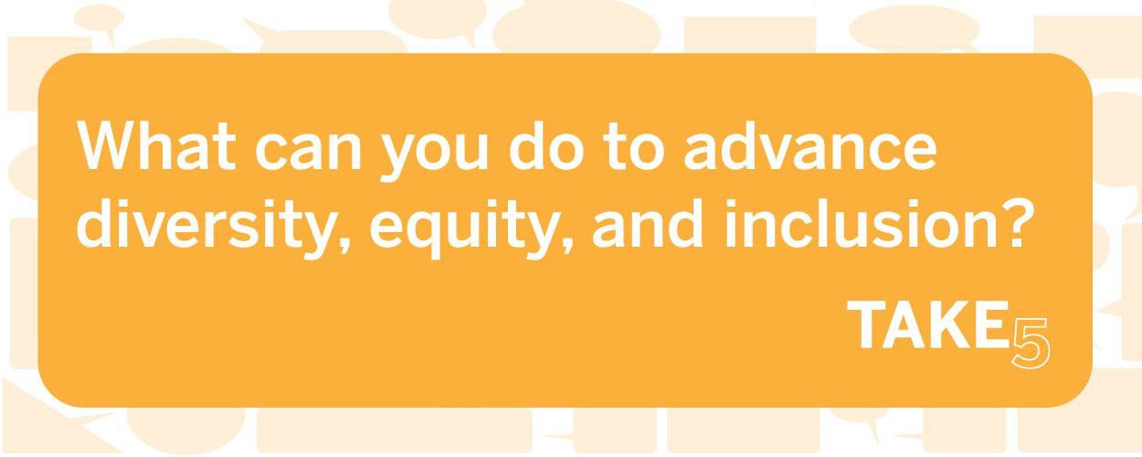
Visit http://www.d5coalition.org/the-take-5-campaign/ today!
30

Slide 31
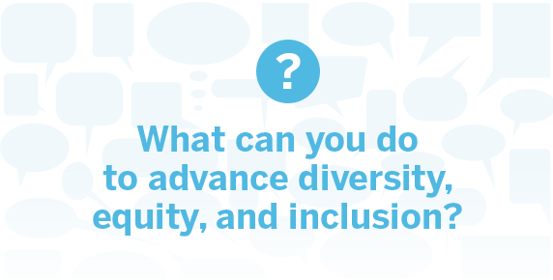
Visit www.D5coalition.org:
  Access a wide range of supportive resources
  Learn about and get involved with Take 5
  Sign-up for our mailing list, newsletter and e-alerts
Visit www.publicinterestprojects.org:
    PowerPoint slides of all webinars in series
    Access resources
Jan. 23: D5: Advancing Issues that are at the Core of All Communities and All Philanthropy
Feb. 20: On-ramps for Every Traveler: Enhancing Impact through Diversity, Equity, and Inclusion
Mar. 27: Elusive Philanthropy Data: Opportunities and Barriers for Collecting Data to Tell Philanthropy’s Full Story
Apr. 17: Commitment from the Top: The Role of Leadership in Advancing Diversity, Equity & Inclusion
May 22: Career Trajectories of People of Color in Philanthropy

Slide 32
WHAT WE DO
THANK YOU
For follow-up inquiries or to register for future webinars, please contact Hafizah Omar with the D5 Coalition at homar@d5coalition.org.

